Slide 1
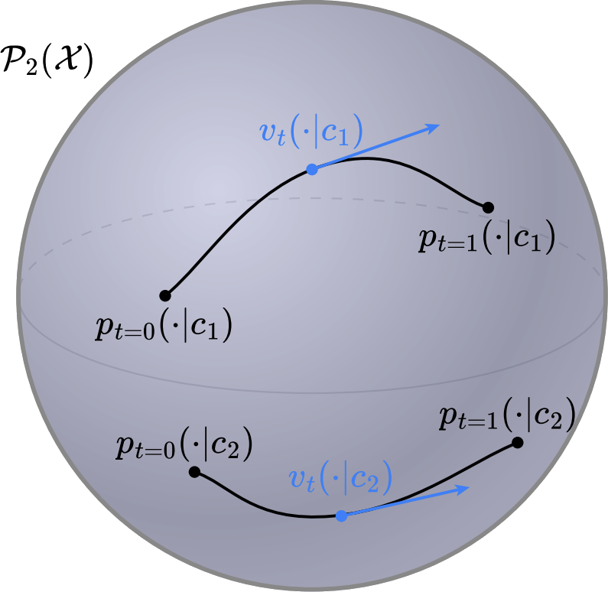

Transport and flows between distributions over distributions
Brandon Amos • Meta, NYC
slides
bamos.github.io/presentations

Slide 2
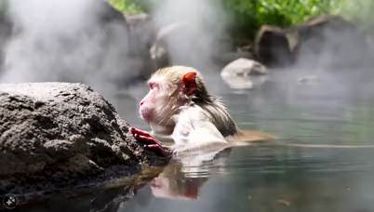
Generative models and media generation
📚 Movie Gen: A Cast of Media Foundation Models. Meta, Oct 2024.
Prompt: A red-faced monkey with white fur is bathing in a natural hot spring. The monkey is playing in the water with a miniature sail ship in front of it, made of wood with a white sail and a small rudder. The hot spring is surrounded by lush greenery, with rocks and trees.

Slide 3
Flows: how we got here
(many extensions/applications)
(a non-exhaustive list)

Slide 4
Flows: how we got here
(many extensions/applications)
(a non-exhaustive list)
(data)
(base)

Slide 5
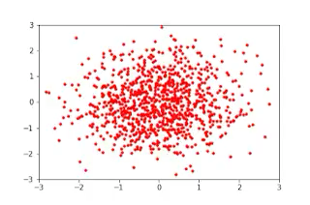
Flows: how we got here
(many extensions/applications)
(a non-exhaustive list)
(data)
(base)
Source: Normalizing Flows in 100 Lines of JAX
parameterize with an invertible function
learn with likelihood

Slide 6
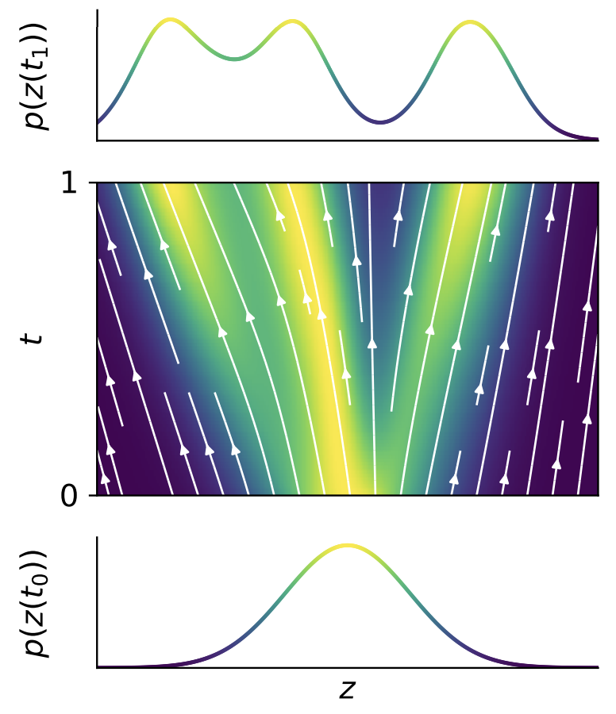
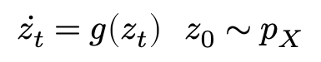
Flows: how we got here
(many extensions/applications)
(a non-exhaustive list)
(data)
(base)
parameterize with an ODE
learn with likelihood
$$\dot{z_{t}}=g\left(z_{t}\right) z_{0}∼p_{X}$$

Slide 7
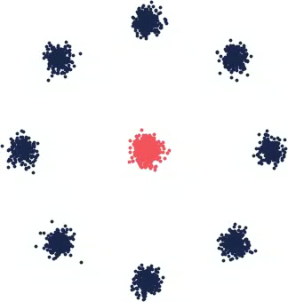
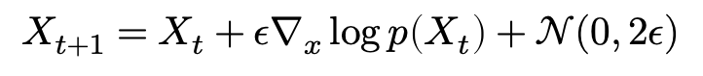
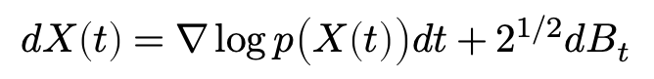
Flows: how we got here
(many extensions/applications)
(a non-exhaustive list)
DDPM
reference path SDE known
score decomposes nicely, learn via a decomposition
$$dX\left(t\right)=∇\log{p\left(X\left(t\right)\right)dt+{\text{2}}^{1/2}dB_{t}}$$
$$X_{t+1}=X_{t}+{ε∇}_{x}\log{p\left(X_{t}\right)+𝒩(0, 2ε)}$$

Slide 8
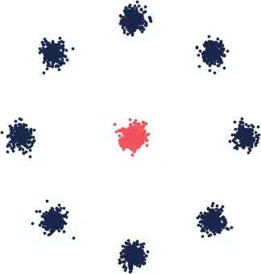
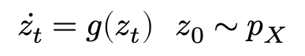
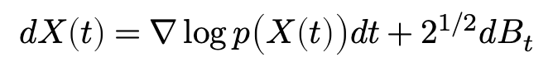
Flows: how we got here
(many extensions/applications)
(a non-exhaustive list)
(data)
(base)
back to an ODE/flow with the same marginals!!
(probability flow ODE, implicit models)
DDPM
DDIM
$$dX\left(t\right)=∇\log{p\left(X\left(t\right)\right)dt+{\text{2}}^{1/2}dB_{t}}$$
$$\dot{z_{t}}=g\left(z_{t}\right) z_{0}∼p_{X}$$

Slide 9
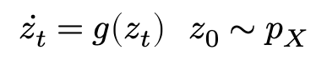
Flows: how we got here
(many extensions/applications)
(a non-exhaustive list)
Match the ODE directly, generalize diffusion path
Still use a ground-truth reference path (or interpolant)
Parameterize flow with an unconstrained neural network
(invertibility comes because the reference transport is invertible!!)
(data)
(base)
$$\dot{z_{t}}=g\left(z_{t}\right) z_{0}∼p_{X}$$

Slide 10
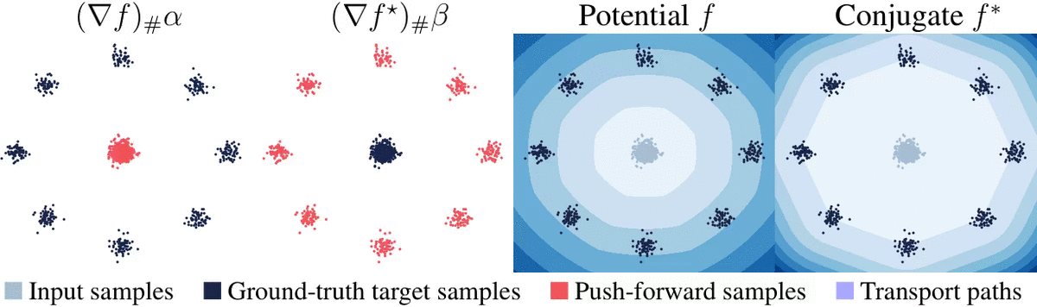
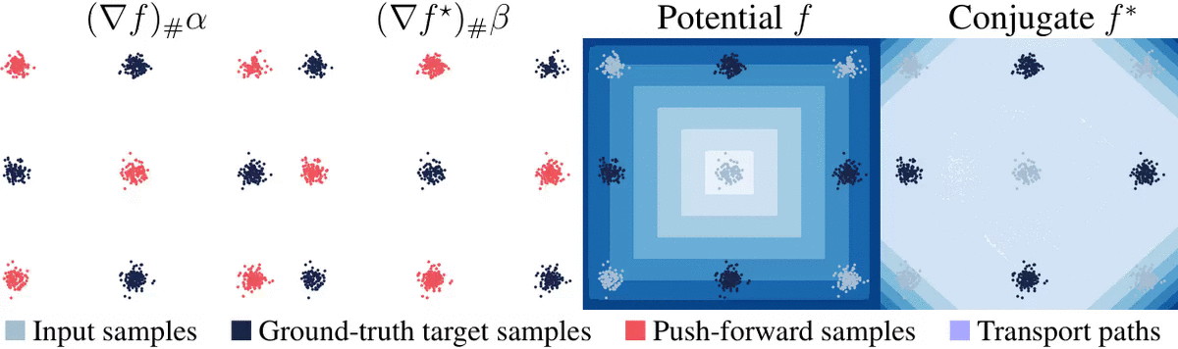
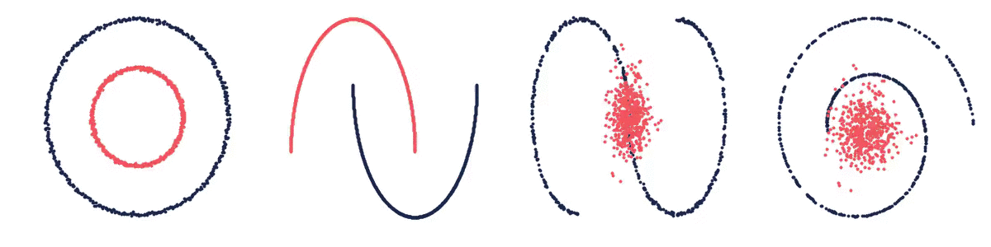
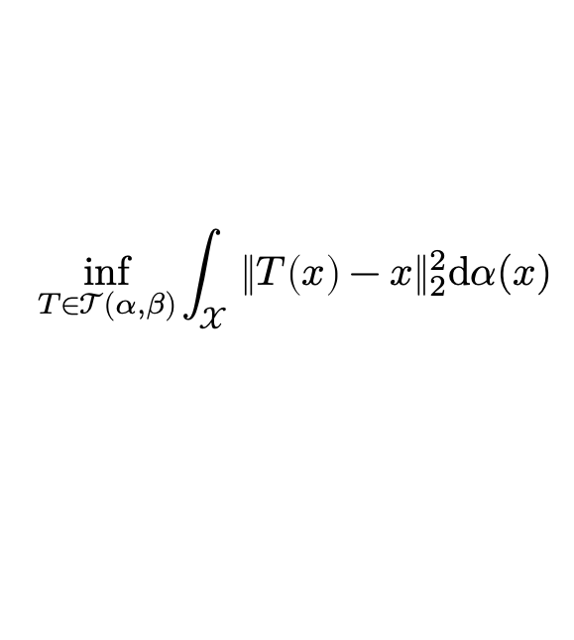
Flows and (optimal )transport
(many extensions/applications)
(a non-exhaustive list)
📚 Optimal transport: old and new. Villani, 2009. 📚 Optimal Transport in Learning, Control, and Dynamical Systems. Bunne and Cuturi, ICML 2023 Tutorial. 📚 Computational Optimal Transport. Peyré and Cuturi, Foundations and Trends in Machine Learning, 2019.
📚 Optimal Transport for Applied Mathematicians. Santambrogio, Birkhäuser, 2015
📚 Optimal Transport in Systems and Control. Chen, Georgiou, and Pavon, 2021.
📚 Optimal mass transport: Signal processing and machine-learning applications. Kolouri et al., 2017.
Monge’s problem (squared Euclidean)
$$\inf_{T∈𝒯(α, β)}{\int_{𝒳}{{\left\|T\left(x\right)−x\right\|}_{2}^{2}\text{d}α(x)}}$$
find a map connecting $α$ and $β$ that minimally displaces mass
📚 On amortizing convex conjugates for optimal transport. Amos, ICLR 2023.

Slide 11
Flows and (optimal )transport
(many extensions/applications)
(a non-exhaustive list)
📚 Optimal transport: old and new. Villani, 2009. 📚 Optimal Transport in Learning, Control, and Dynamical Systems. Bunne and Cuturi, ICML 2023 Tutorial. 📚 Computational Optimal Transport. Peyré and Cuturi, Foundations and Trends in Machine Learning, 2019.
📚 Optimal Transport for Applied Mathematicians. Santambrogio, Birkhäuser, 2015
📚 Optimal Transport in Systems and Control. Chen, Georgiou, and Pavon, 2021.
📚 Optimal mass transport: Signal processing and machine-learning applications. Kolouri et al., 2017.
Monge’s problem (squared Euclidean)
$$\inf_{T∈𝒯(α, β)}{\int_{𝒳}{{\left\|T\left(x\right)−x\right\|}_{2}^{2}\text{d}α(x)}}$$
all of this: single distribution to single distribution
find a map connecting $α$ and $β$ that minimally displaces mass
📚 On amortizing convex conjugates for optimal transport. Amos, ICLR 2023.

Slide 12
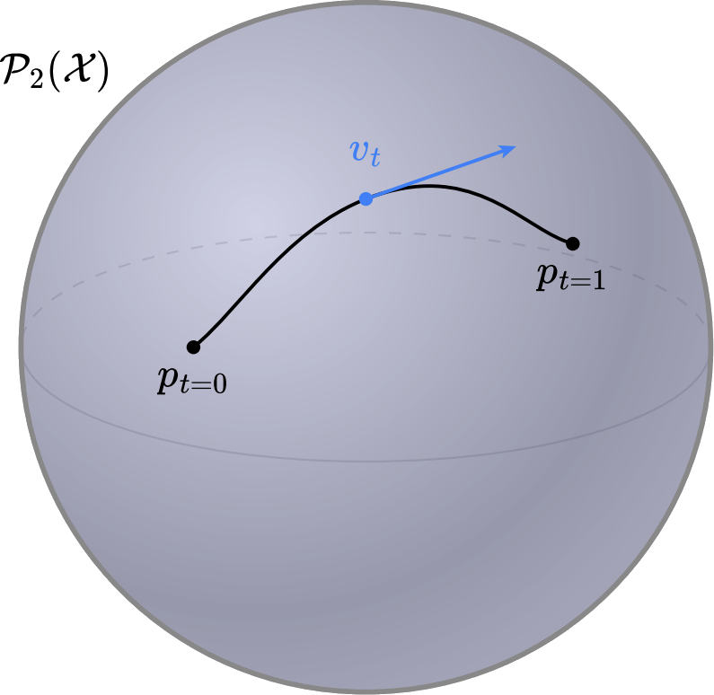
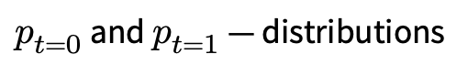
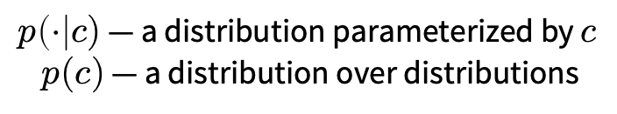
To distributions over distributions
single flow
multiple flows
(Wasserstein manifold)
$p_{t=0}$ and $p_{t=1}$ — distributions
$p\left(⋅\right|c)$ — a distribution parameterized by $c$
$p(c)$ — a distribution over distributions

Slide 13
Why distributions over distributions?
Text to image, video, or other media between many text prompts

Slide 14
Why distributions over distributions?
Text to image, video, or other media between many text prompts
Image editing between many pairs of images
📚 Meta Optimal Transport. Amos et al., ICML 2023.

Slide 15
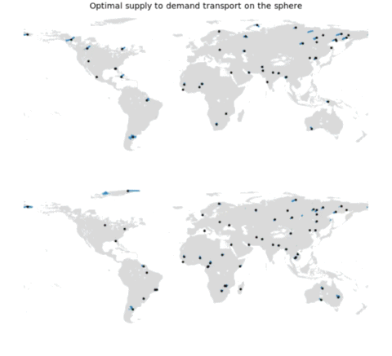
Why distributions over distributions?
Text to image, video, or other media between many text prompts
Image editing between many pairs of images
Scheduling and supply-demand allocations between many initial conditions
📚 Meta Optimal Transport. Amos et al., ICML 2023.

Slide 16
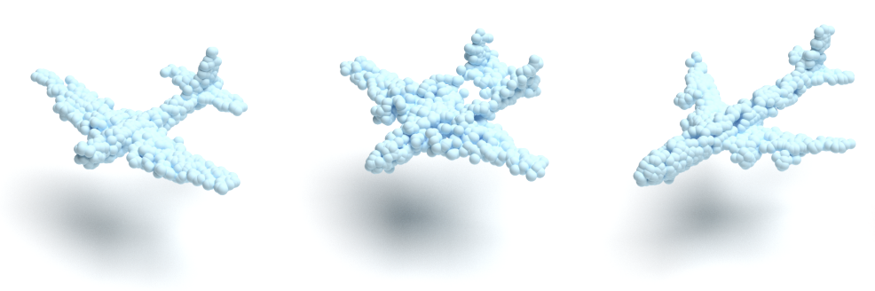
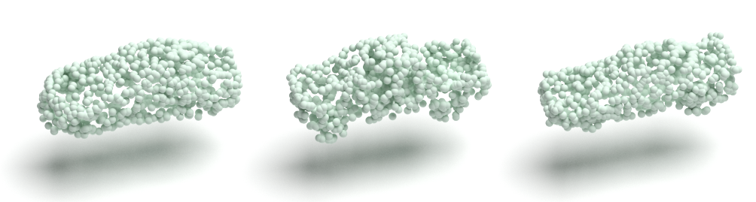
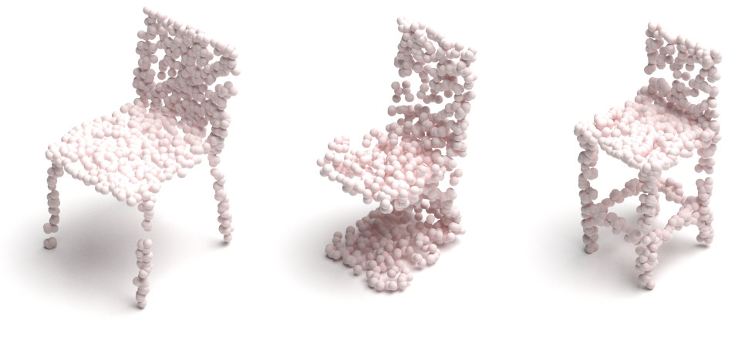
Why distributions over distributions?
Text to image, video, or other media between many text prompts
Image editing between many pairs of images
Scheduling and supply-demand allocations between many initial conditions
Point cloud generation each point cloud is an empirical distribution
📚 Wasserstein Flow Matching. Haviv*, Pooladian*, Pe’er, Amos. 2024.

Slide 17
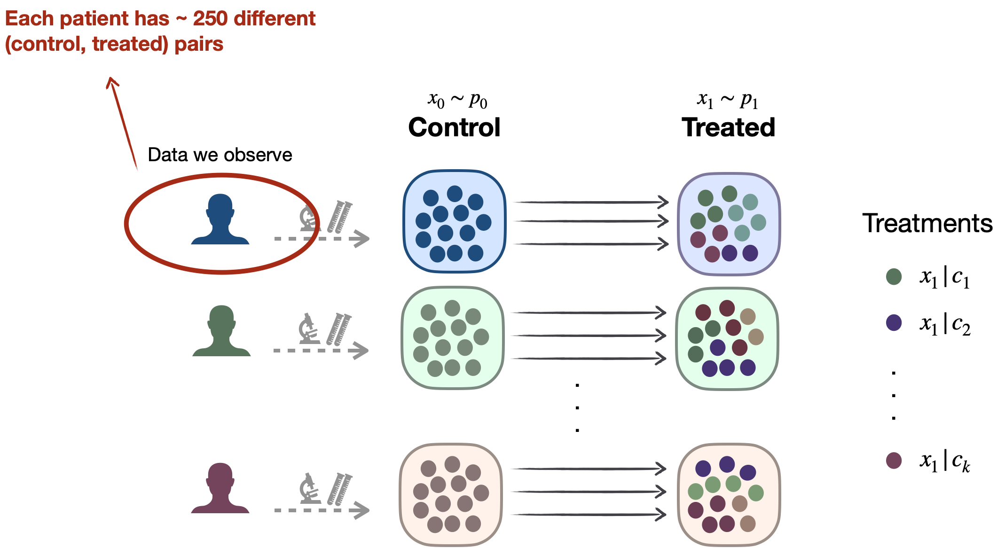
Why distributions over distributions?
Text to image, video, or other media between many text prompts
Image editing between many pairs of images
Scheduling and supply-demand allocations between many initial conditions
Point cloud generation each point cloud is an empirical distribution
Cellular transport many pairs of untreated to treated populations
📚 Meta Flow Matching. Atanackovic et al., 2024.

Slide 18
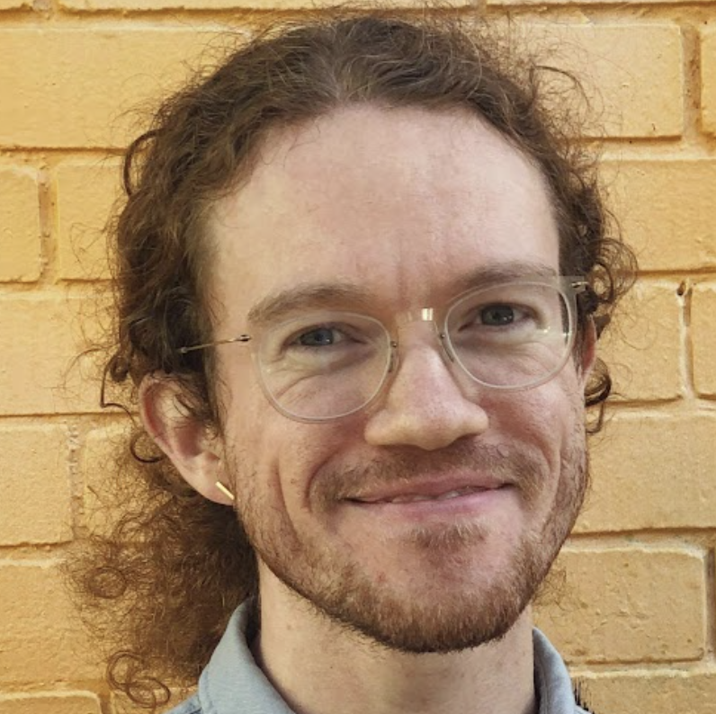
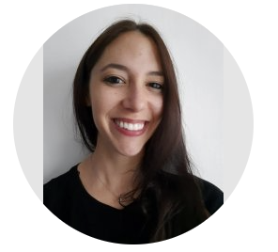
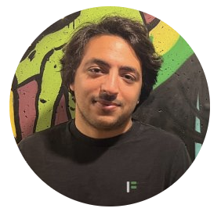
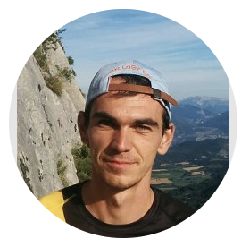
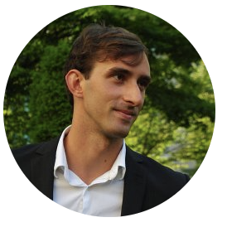
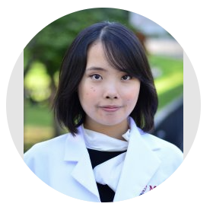
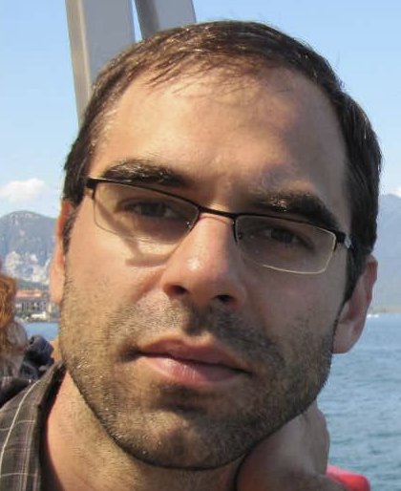
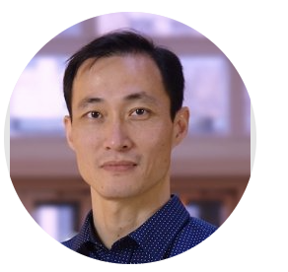
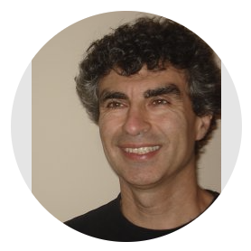
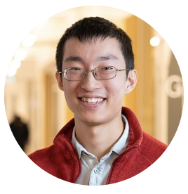

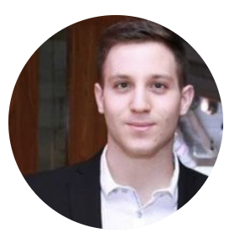
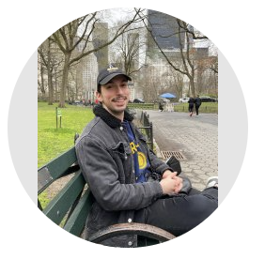
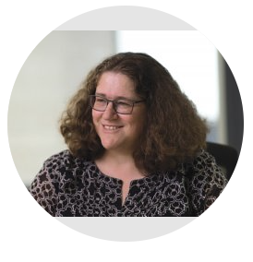
Talk overview
📚 Meta Optimal Transport [ICML 2023]
📚 Meta Flow Matching [2024]
📚 Wasserstein Flow Matching [2024]

Slide 19
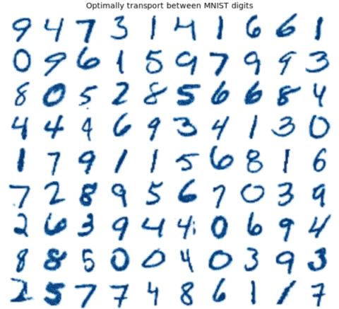
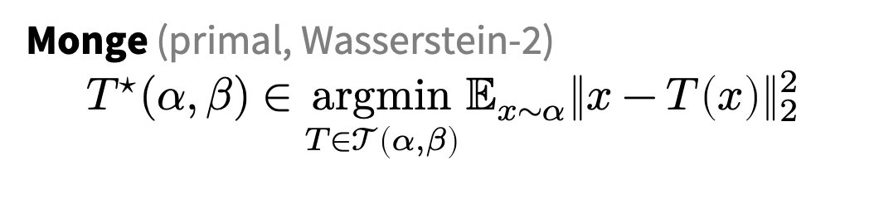
Challenge: computing OT maps
📚 Meta Optimal Transport. Amos et al., ICML 2023.
Monge (primal, Wasserstein-2)
$${T^{⋆}(α, β)∈\underset{T∈𝒯\left(α, β\right)}{argmin}{𝔼_{x∼α}\left\|x−T\left(x\right)\right\|}}_{2}^{2}$$
we also consider other/discrete OT formulations
Many OT problems are numerically solved
Improving OT solvers is active research
Solving multiple OT problems: even harder
Standard solution: independently solve

Slide 20
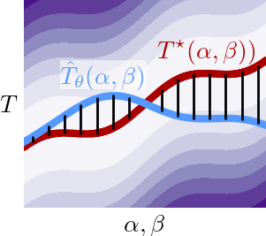
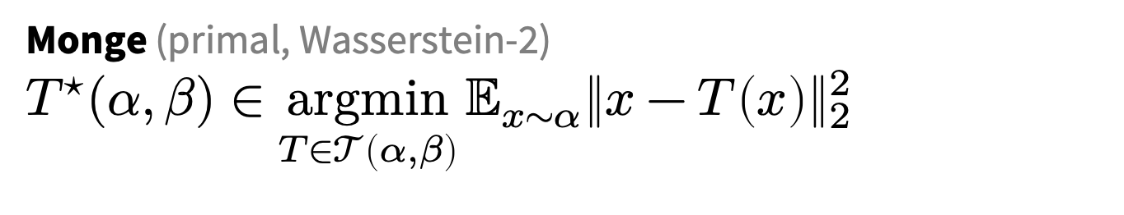

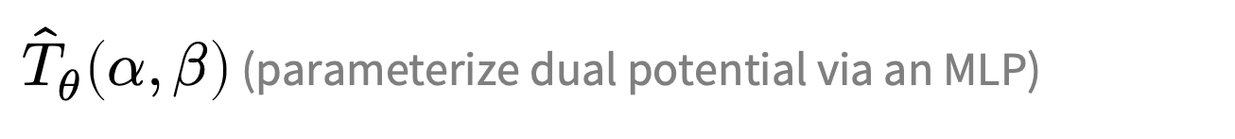
Meta Optimal Transport
Idea: predict the solution to OT problems with amortized optimization
Simultaneously solve many OT problems, sharing info between instances
Why call it “meta”? Instead of solving a single OT problem, learn how to solve many
(via amortization)
Monge (primal, Wasserstein-2)
$${T^{⋆}(α, β)∈\underset{T∈𝒯\left(α, β\right)}{argmin}{𝔼_{x∼α}\left\|x−T\left(x\right)\right\|}}_{2}^{2}$$
$$≈$$
${\hat{T}}_{θ}\left(α, β\right)$ (parameterize dual potential via an MLP)
we also consider other/discrete OT formulations

Slide 21
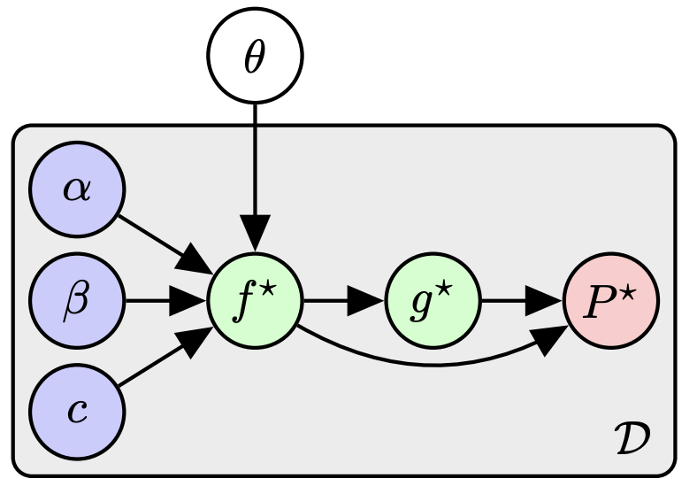
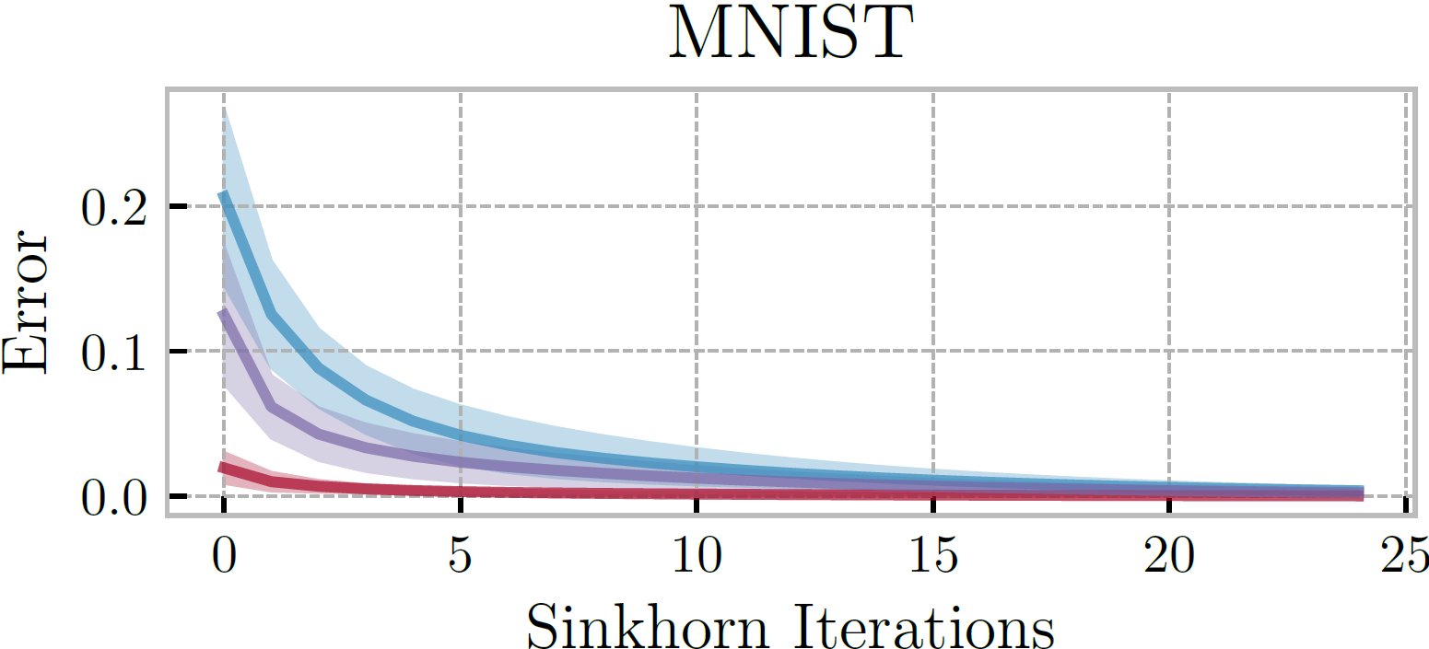
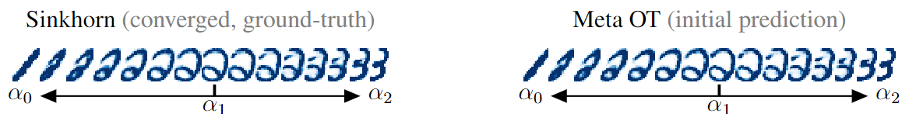
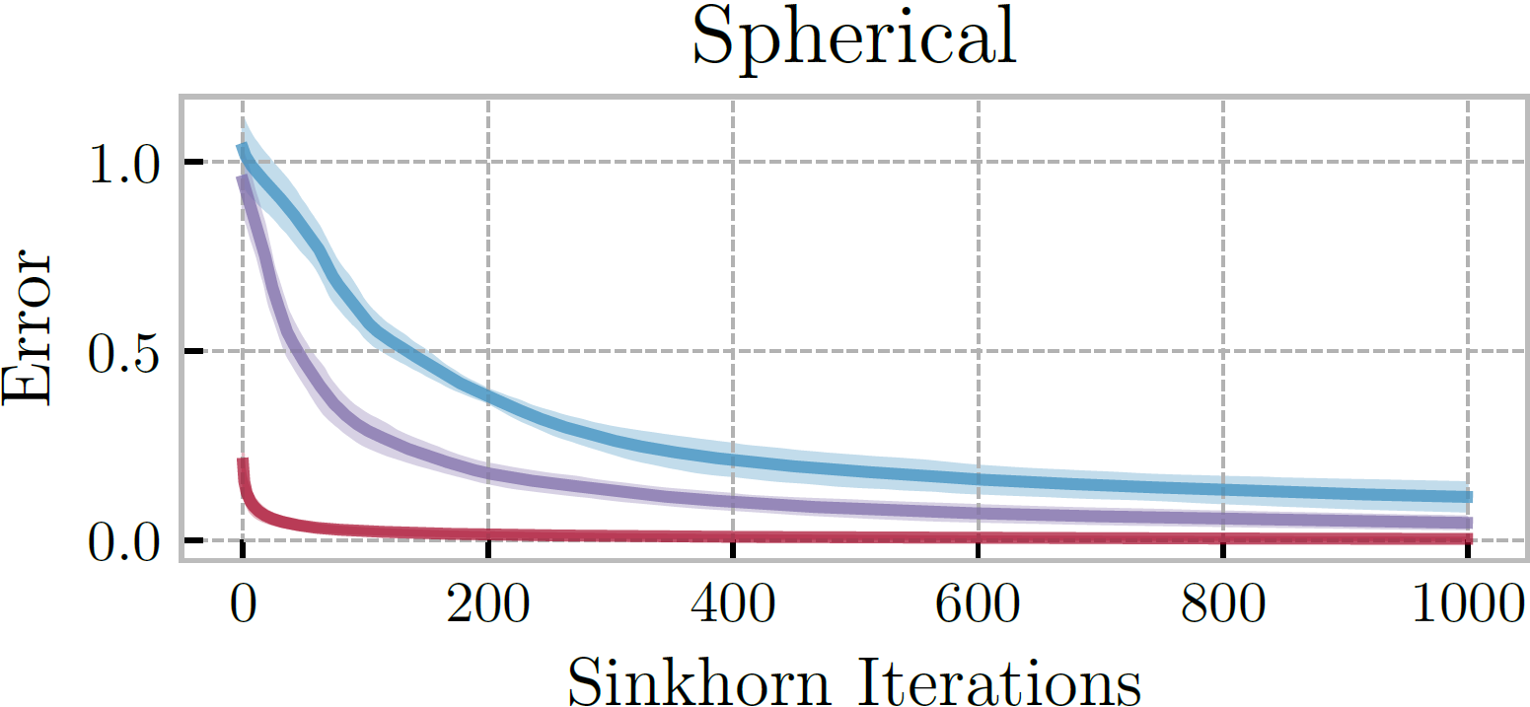
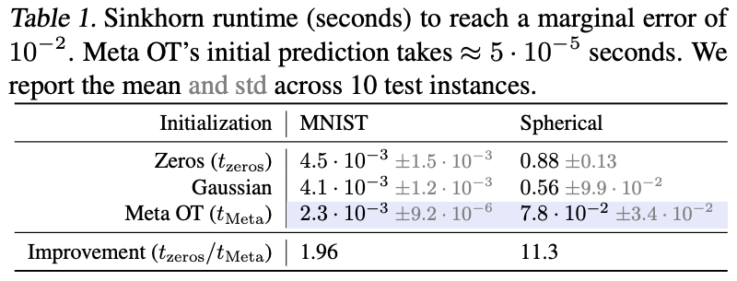
Meta OT for Discrete OT (Sinkhorn)
📚 Sinkhorn Distances: Lightspeed Computation of Optimal Transport. Marco Cuturi, NeurIPS 2013.

Slide 22
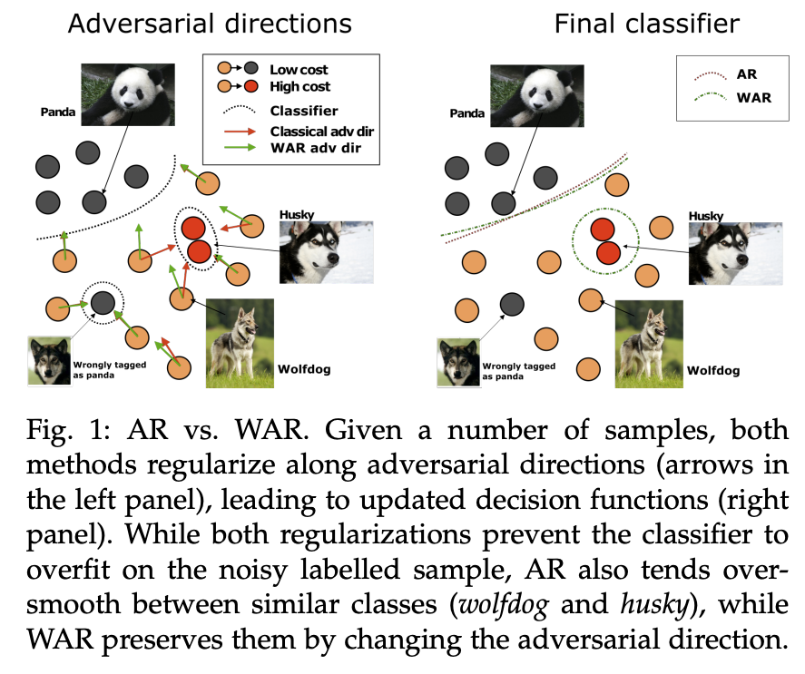
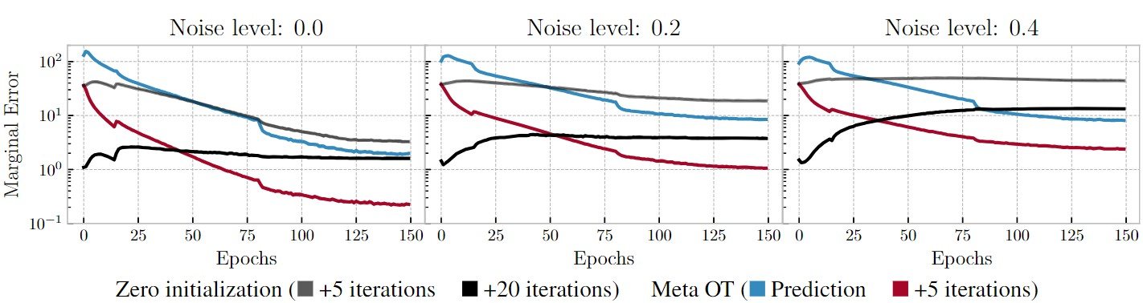
Wasserstein adversarial regularization
📚 Wasserstein adversarial regularization for learning with label noise. Kilian Fatras et al., TPAMI 2021.
Setting: discrete OT for classification with label noise
OT is repeatedly solved across minibatches
Use Meta OT to learn better solutions

Slide 23
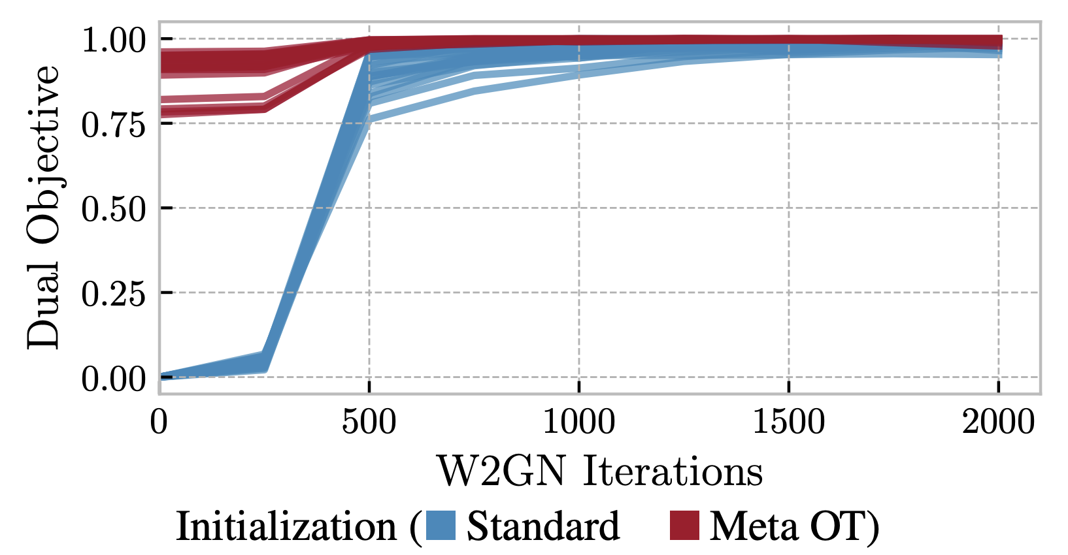

Meta OT in continuous settings (W2GN)
📚 Wasserstein-2 Generative Networks. Alexander Korotin et al., ICLR 2021.
RGB color palette transport

Slide 24
More Meta OT color transfer predictions
📚 Meta Optimal Transport. Amos et al., ICML 2023.

Slide 25



Conditional Monge Maps
📚 Supervised Training of Conditional Monge Maps. Bunne, Krause, Cuturi, NeurIPS 2022.
Focus: predicting drug treatments with OT
Idea: condition OT map on patient information
Methodological differences
Conditional Monge Maps $≈$ Neural Processes
Predict conditioning inputs of the OT map Meta OT $≈$ Hyper-Networks
Predict parameters of an OT map
image sources: Bunne and Cuturi

Slide 26
Talk overview
📚 Meta Optimal Transport [ICML 2023]
📚 Meta Flow Matching [2024]
📚 Wasserstein Flow Matching [2024]

Slide 27











Background and Motivation
In many scientific problems, we want to understand the dynamics of many-body problems (the dynamic evolution of interacting particles)
E.g. the dynamic processes cells undergo w.r.t. their environment and interactions with each other
$$p_{t}$$
$$p_{0}$$
$$p_{1}$$

Slide 28




Background and Motivation
We want to model the dynamics of particles (or cells) at the population level. Many methods do this:
Tong et al, ICML, 2020
Bunne et al, Nature Methods, 2023
Neklydov et al, ICML, 2024
Schiebinger et al, Cell, 2019
Existing methods typically only model the evolution of cells as independent particles.

Slide 29


Background and Motivation
We would also like a model that can generalize across measures (populations)
Data we observe
$$x_{0}∼p_{0}$$
$$x_{1}∼p_{1}$$
.
.
.
“unseen” population
Existing methods are typically restricted to a single measure (population, patient). At best can condition on different dynamics.

Slide 30



Problem setup
We want a model that can:
1. model the evolution of particles while taking into account their interactions
2. generalize across unseen populations
$$x_{0}∼p_{0}$$
$$x_{1}∼p_{1}$$
Main assumptions:
1. Coupled distribution/population pairs $\{(p_{0}(x_{0}|i),p_{1}(x_{1}|i))\}_{i=1}^{N}$ 2. The collected data undergoes a universal developmental process depends only on the population itself (e.g., interacting particles or communicating cells)
$$p_{0}$$
$$p_{1}$$

Slide 31



From Flow Matching to Meta Flow Matching
$$\frac{∂p_{t}(x)}{∂t}=−⟨∇_{x},p_{t}(x)v_{t}^{∗}(x)⟩$$
(Wasserstein manifold)
$p_{t=0}$ and $p_{t=1}$ — distributions
$p\left(⋅\right|c)$ — a distribution parameterized by $c$
$p(c)$ — a distribution over distributions

Slide 32



From Flow Matching to Meta Flow Matching
$$\frac{∂p_{t}(x)}{∂t}=−⟨∇_{x},p_{t}(x)v_{t}^{∗}(x)⟩$$
$$\frac{∂p_{t}(x)}{∂t}=−⟨∇_{x},p_{t}(x)v_{t}^{∗}(x,p_{t})⟩$$
(from assumptions: end up just conditioning on $p_{0}$)
(Wasserstein manifold)
$p_{t=0}$ and $p_{t=1}$ — distributions
$p\left(⋅\right|c)$ — a distribution parameterized by $c$
$p(c)$ — a distribution over distributions

Slide 33











Meta Flow Matching
A model to learn to represent the population (GCN w/ knn edge pooling)
$$(x(t_{0}),t_{0})$$
$$h$$
$$(x(t_{0}),t_{0})$$
$$φ(p_{0},θ)$$
$v$ approximates the population dynamics given 1. representation of the population, and 2. additional seen conditions $c$ (e.g. treatments applied to population)
$$φ(p_{0},θ)$$
$$c$$
$$v_{t}(x,h,c;ω)$$
.
.
.
$$h=φ(p_{0},θ)$$
$$φ(p_{0},θ)$$
$φ(p_{0},θ)$ (GCN) captures interactions between particles

Slide 34


Slide 35





Synthetic Example
We create a synthetic dataset of paired joint distributions $\{(p_{0}(x_{0}|i),p_{1}(x_{1}|i))\}_{i=1}^{N}$
We define a set of pre-defined target distributions $p_{1}(x_{1}|i)$ for $i=1,…,N$ (letter silhouettes)
To get paired $p_{0}(x_{0}|i)$ we simulate the forward diffusion process without drift $x_{0}∼𝒩(x_{1},σ)$
We reverse the diffusion process and learn the push-forward map from $p_{0}(x_{0}|i)$ (source) to $p_{1}(x_{1}|i)$ (target) for every index $i$
Train: 24 letters (excluding ‘Y’ and ‘X’), each in 10 orientations
Test: ’Y’ and ‘X’, each in 10 orientations
source
target
source
target

Slide 36



Synthetic Example (FM baseline)
No population information
Predicts aggregate response over populations
Train
$$(x(t_{0}),t_{0})$$
$$v_{t}(x;ω)$$
Test
FM cannot fit the training data and cannot generalize to unseen populations

Slide 37





Synthetic Example (CGFM baseline)
“Perfect” conditions (naive)
A model $v$ to approximate the dynamical response given the population index/condition $c$
$$(x(t_{0}),t_{0})$$
Train
$$v_{t}(x,c;ω)$$
Test
$$c$$
Perfect information on which environment the model is working with
CGFM cannot generalize to the conditions of unseen populations

Slide 38





Synthetic Example (MFM)
Learned Conditions
A model $v$ to approximate the dynamical response given a learned representation of the population
$$(x(t_{0}),t_{0})$$
Train
$$v_{t}(x,h;ω)$$
$$h=φ(p_{0},θ)$$
Test
MFM learns to represent entire populations, hence generalizes across unseen populations

Slide 39


Synthetic Example

Slide 40






Biological data — patient-specific organoid drug screen dataset
Each patient has ~ 250 different (control, treated) pairs
Mass Cytometry
$$x_{0}∼p_{0}$$
$$x_{1}∼p_{1}$$
Control
Treated
Data we observe
Treatments
$$x_{1}|c_{1}$$
$$x_{1}|c_{2}$$
.
.
.
.
.
.
$$x_{1}|c_{k}$$
(Zapatero et al, Cell, 2023)
10 patients, 11 treatments, varying doses, 3 different cell cultures … up to 2500 different environmental conditions! (we use ~ 1000)

Slide 41

Organoid Drug Screen Data

Slide 42

“Replica” Split

Slide 43

Patient Split

Slide 44
Talk overview
📚 Meta Optimal Transport [ICML 2023]
📚 Meta Flow Matching [2024]
📚 Wasserstein Flow Matching [2024]

Slide 45
So far: distributions over pairs of distributions
Meta OT and Meta FM assume (coupled) pairs of distributions
source
target
Control
Treated

Slide 46


What if we have unpaired distributions?
📚 Wasserstein Flow Matching. Haviv, Pooladian, Pe’er, Amos. 2024.
Still can learn a flow between them
(we also can’t simply flatten them into a mixture)

Slide 47

Why would we have unpaired distributions?
Want to do generative modeling where the data points are inherently distributions
point clouds
biological data

Slide 48

Related: flows for categorical distributions
📚 Dirichlet Flow Matching. Stark et al., NeurIPS 2024. 📚 Fisher Flow Matching. Davis et al., ICML 2024.

Slide 49


How to flow on the Wasserstein manifold?
📚 Riemannian Flow Matching. Chen and Lipman, ICLR 2024.
Use Riemannian flow matching with the geodesics (OT paths) on the Wasserstein manifold

Slide 50

Point cloud generation results
Competitive and don’t require spatially discretizing the domain like most of the baselines

Slide 51

WFM also does interpolations and completions
Flow from a distribution over lamps to a distribution over handbags
Completion using a flow trained over a distribution of planes

Slide 52
Transport and flows between distributions over distributions
Brandon Amos • Meta, NYC
slides
bamos.github.io/presentations

